Slide 1
Module5_SelfOrganizingMaps
Reference:
S. Haykin (1999). Neural Networks. A Comprehensive Foundation, Second Edition, Prentice-Hall, Inc., New Jersey, 1999, pp.443-465.
Ethem Alpaydin, "Introduction to Machine Learning”, MIT Press, Prentice Hall of India

Slide 2
Introduction
Self-Organizing Map (SOM) is an extension of NN developed by the Finnish Neural Network pioneer Teuvo Kohonen in the early 1980s.
Competitive Neural Networks represent a type of ANN model in which neurons in the output layer compete with each other to determine a winner.
The winner indicates which prototype pattern is the most representative of (most similar to) the input pattern.
The competition among output layer neurons is implemented by lateral inhibition - a set of negative connections between the neurons.
The most well known among this paradigm of ANNs is the Self-organizing Map (SOM), also known as the Kohonen net.

Slide 3
Self-Organizing paradigm
Learning in biological systems :
The type of learning in multilayer perceptrons requires the correct response to be provided during training (supervised training).
Biological systems display this type of learning, but they are also capable of learning by themselves - without a supervisor showing the correct response (unsupervised learning).
A neural network with a similar capability is called a self-organising system because during training, the network changes its weights to learn appropriate associations, without any right answers being provided.

Slide 4
Self-Organizing paradigm
Self-organizing map (SOM) is an extension of NN developed by the Finnish Neural Network pioneer Teuvo Kohonen in the early 1980s.
The neurons in a SOM are organized in a regular two-dimensional grid.
Each neuron has a weight or state vector.
When an input (which is in the form as the state vectors) is presented, the neuron whose state vector is closest (in Euclidean distance) to the input vector is activated.
This neuron is called the "winner".
The learning rule modifies the state of the winner so that it becomes even more similar to the input vector.

Slide 5
Self-Organizing paradigm
An important feature of the learning procedure is that, the neurons that are next to the winner in the grid, which are the neighbors of the winner, are also modified in a similar fashion.
A consequence of the learning procedure is that the state vectors of neurons that are located near each other in the grid tend to become more and more similar.
Eventually, the result is a map where similar inputs activate nearby neurons. A typical application of the SOM is data visualization.

Slide 6
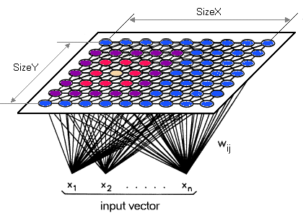
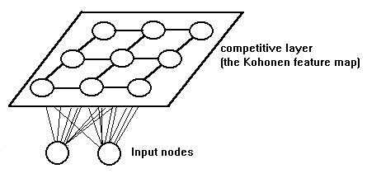
Kohonen Network - Architecture
The Kohonen network consists of an input layer, which distributes the inputs to each node in a second layer, the so-called competitive layer.
Each of the nodes on this layer acts as an output node.
Each neuron in the competitive layer is connected to other neurons in its neighbourhood and feedback is restricted to neighbours through these lateral connections.

Slide 7
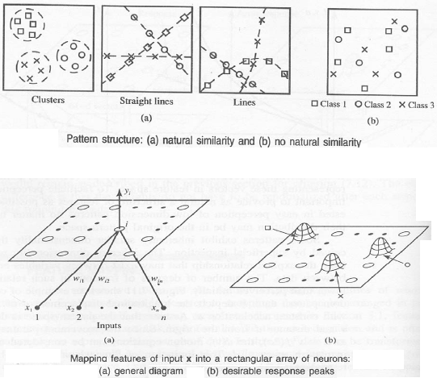
Example

Slide 8
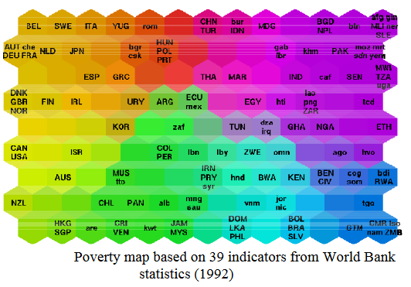
Example

Slide 9
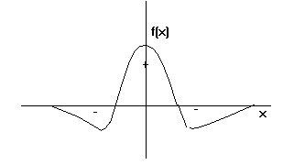
Self-Organizing paradigm
The propagation of biological neural activation via axons can be modelled using a Mexican hat function:
Cells close to the active cell have excitatory links. The strengths of the links drop off with distance and then turn inhibitory. The Kohonen neural network uses only locally connected neurons and restricts the adjustment of weight values to localised "neighbourhoods".

Slide 10
Kohonen Network - Architecture
Neurons in the competitive layer have excitatory connections to immediate neighbours and inhibitory connections to more distant neurons.
All neurons in the competitive layer receive a mixture of excitatory and inhibitory signals from the input layer neurons and from other competitive layer neurons.
SOM provides a data visualization technique which helps to understand high dimensional data by reducing the dimensions of data to a map.
SOM also represents clustering concept by grouping similar data together. Therefore it can be said that SOM reduces data dimensions and displays similarities among data.
With SOM, clustering is performed by having several units compete for the current object.

Slide 11
Kohonen Network
As an input pattern is presented, some of the neurons are sufficiently activated to produce outputs which are fed back to other neurons in their neighbourhoods.
The node with the weight vector closest to the input pattern vector (the so-called "winning node") produces the largest output.
During training, input weights of the winning neuron and its neighbours are adjusted to make them resemble the input pattern even more closely.
At the completion of training, the winning node ends up with its weight vector aligned with the input pattern and produces the strongest output whenever that particular pattern is presented.

Slide 12
Kohonen Network
The nodes in the winning node's neighbourhood also have their weights modified to settle down to an average representation of that pattern class.
As a result, unseen patterns belonging to that class are also classified correctly (generalisation).
The m neighbourhoods, corresponding to the m possible pattern classes are said to form a topological map representing the patterns.
The initial size of the neighbourhood and the fixed values of excitatory (positive) and inhibitory (negative) weights to neurons in the neighbourhood are among the design decisions to be made.

Slide 13
Derivation of the learning rule for the Kohonen Network
The sum squared error for pattern p for all output layer neurons can be written as
where x_{j}^{p} is the i^{th} component of pattern p for neuron j. The summation is done over all j neurons.
Any change Δw_{ij} in the weight is expected to cause a reduction in error E_{p}.
E_{p} is a function of all the weights, so its rate of change with respect to any one weight value w_{ij} has to be measured by calculating its partial derivative with respect to w_{ij}.

Slide 14

Derivation of the learning rule for the Kohonen Network
where η is a constant of proportionality
From E_{p}, we have
Hence,

Slide 15
Training the Kohonen Network
The training involves tree main phases:
Competition: the neurons in the Kohonen layer compute a certain function, and thus generate outputs that are compared for selection of a winner.
Cooperation: the winner is taken as a basis for cooperation and it determines the topological neighborhood within which the example falls.
Adaptation: the neurons are adjusted to reflect the information in the provided training example by updating their weights so that the neuron output changes correspondingly.

Slide 16
Training the Kohonen Network
The Kohonen Algorithm
1. Initialise weights
Initialise weights from N inputs to the nodes (to small random values). Set the initial radius of the neighbourhood.
2. Present new input x_{o}(t),x₁(t),x₂(t), ..x_{n-1}(t), where x_{i}(t) is the input to node i at time t.
3. Compute distances to all nodes
Compute distances d_{j} between the input and each output node j using
N-1
d_{j} = ∑(x_{i}(t)- w_{ij}(t))² i=0
where x_{i}(t) is the input to node i at time t and w_{ij}(t) is the weight from input node i to output node j at time t.

Slide 17
Training the Kohonen Network
4. Select output node with minimum distance
Select output node j* as the output node with minimum d_{j}.
5. Update weights to node j* and neighbours
Weights updated for node j* and all nodes in the neighbourhood defined by N_{j}*(t). New weights are
w_{ij}(t + 1) = w_{ij}(t) + η(t)(x_{i}(t) - w_{ij}(t))
for j in N_{j}*, 0 ≤ i ≤ N-1
The term η(t) is a gain term 0 ≤ η ≤ 1. Both η and Nj*(t) decrease with time.
6. Repeat by going to step 2

Slide 18
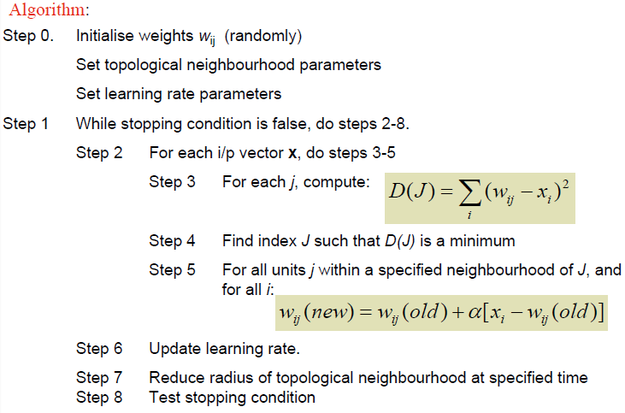
Kohonen Algorithm

Slide 19
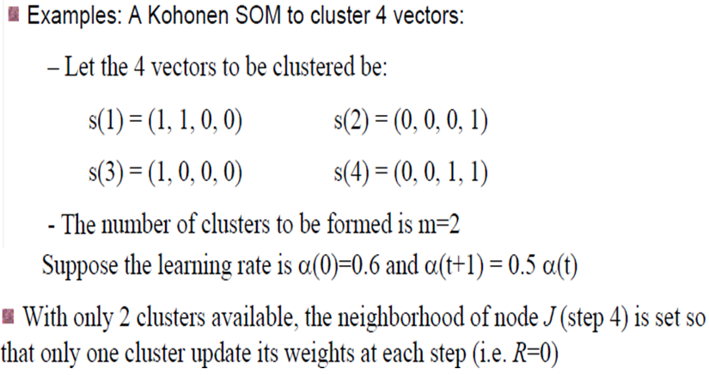
Example

Slide 20
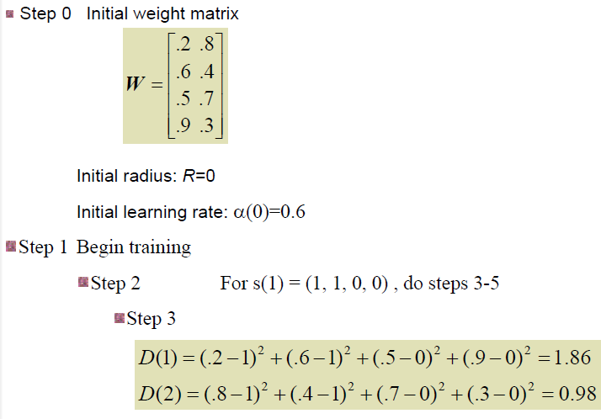
Example

Slide 21
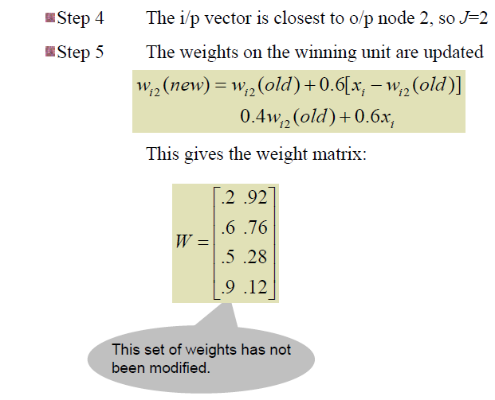
Example

Slide 22
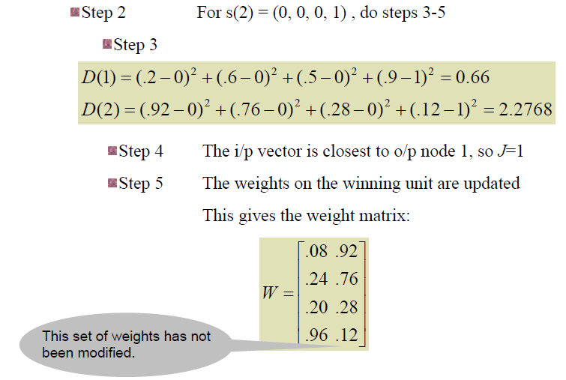
Example

Slide 23
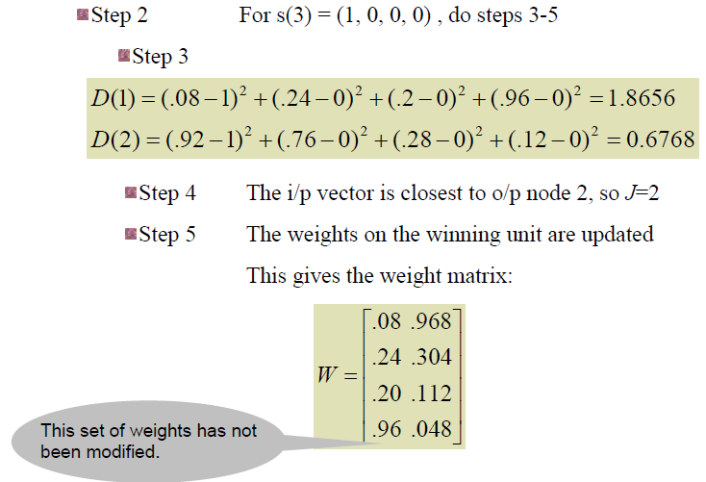
Example

Slide 24
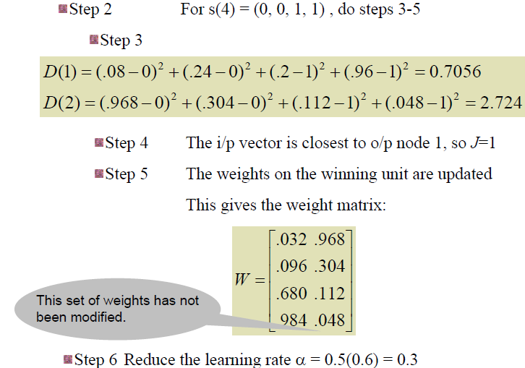
Example

Slide 25
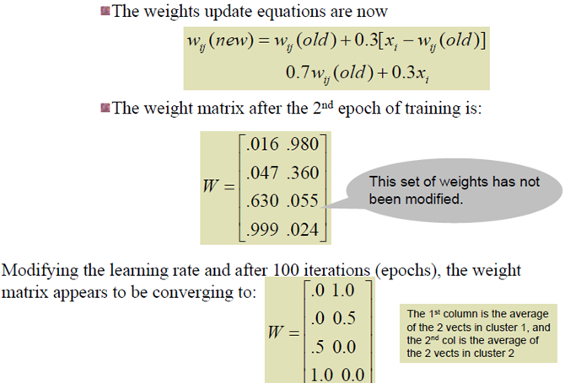
Example

Slide 26
References
http://www.ai-junkie.com/ann/som/som2.html
http://homepages.gold.ac.uk/nikolaev/311koh.htm
S. Haykin (1999). Neural Networks. A Comprehensive Foundation, Second Edition, Prentice-Hall, Inc., New Jersey, 1999, pp.443-465.
http://www.pitt.edu/~is2470pb/Spring05/FinalProjects/Group1a/tutorial/som.html
http://mnemstudio.org/neural-networks-kohonen-self-organizing-maps.htm
http://homepages.gold.ac.uk/nikolaev/311koh.htm

